Slide 1

.NET Brown Bag
Lunch
Today’s Topic:
Dissecting the
Windows WAV File
Presenters:
Ritchie Carroll &
Christian Carroll
TRO - Control Systems
August 30, 2007
Notes:
Background: My son, Christian, starting taking music lessons several years ago learning to play the piano, but I’ve never learned to read music – it looks like a foreign language to me so I’m not much help to him. However, I’ve always had an appreciation for music and I was fascinated at how my son could take these musical symbols and turn them into perfectly timed musical notes. I tried pressing a few keys on the piano and Christian told me that I had better to stick to my strengths; so I decided to learn about what a note was and how they are encoded into a computer. Now my son reads the notes and I can put them in the computer (play Jingle Bells)…

Slide 2
The WAV File
WAV (pronounced “wave”), is the file extension for Windows sound files – it is an acronym for:
Waveform Audio Format
A WAV file fundamentally contains an encoded digital representation of a period of sound
The file format is a Microsoft and IBM audio file format standard for storing raw audio on PC’s
It is a variant of the RIFF bitstream format method for storing data in "chunks", and thus also close to the IFF and the AIFF format used on Amiga and Macintosh computers
Notes:
Today’s topic will lift the cover on the internal details of the pervasive Windows WAV file, however, in order to understand that contents of a WAV file we’ll need a short overview in the basics of sound energy and digital signal processing. So let’s start there…

Slide 3

What is Sound?
A.T.&T. once described sound in these terms, "Audible sound is thus defined as a disturbance in the atmosphere whereby a form of wave motion is propagated from some source at a velocity of 1,075 feet per second, the transmission being accomplished by alternating condensations and rarefacations of the atmosphere in cycles having a fundamental frequency ranging somewhere between 16 per second and 32,000 per second.“
Principles of Electricity applied to Telephone and Telegraph Work, American Telephone and Telegraph. C.F. Myers, Supervisor of Instruction. Murray Hills, New Jersey 1939. p.66

Slide 4
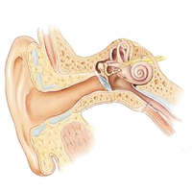
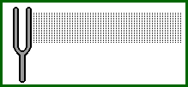
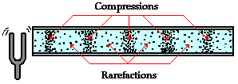
Sound Energy
A sound wave is a transmission of energy by caused by a series of vibrations.

Slide 5

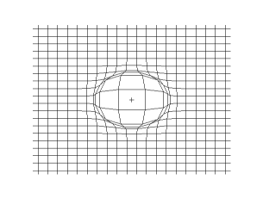
Pressure Wave
The source of sound energy is a vibrating object – as this energy travels through its fluid medium (e.g., air), the energy movement is called a Pressure Wave.
Wave cross section from the side
3D view of wave from above
Notes:
Think of sound energy like you would ripples in a pond. If you were to throw a stone into the middle of a still pond, the ripples would emanate in all directions. Sound is much the same, yet it has a 3-D spherical distribution.

Slide 6
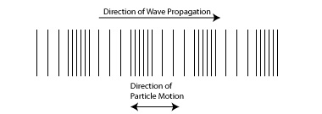
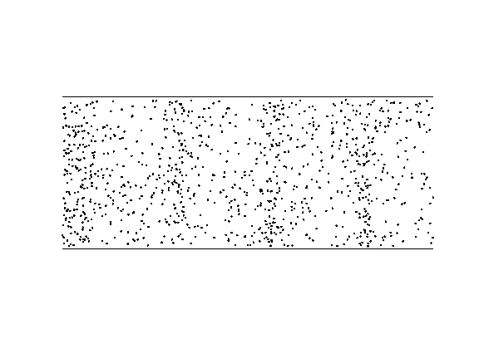
Longitudinal Waves
Sound waves are examples of longitudinal waves: the individual particles (e.g., air molecules) vibrate back and forth in the direction that the sound is traveling (watch movie).
Notes:
After movie – reinforce the idea with a line of people, one person at beginning of the line being a sound vibration source, person at the end being an ear drum and all other being free floating air molecules that move back-and-forth.

Slide 7
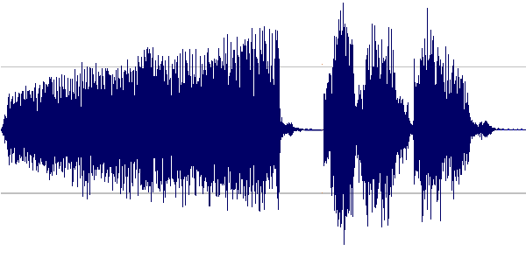
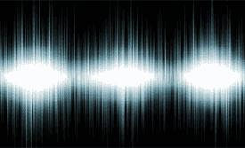
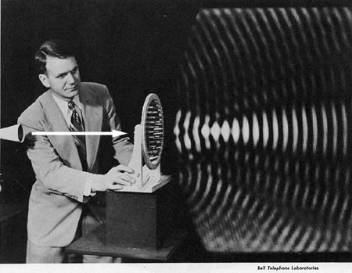
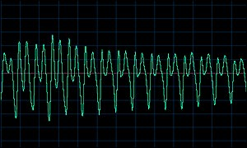
The Audio Waveform
Like all forms of energy, sound can be represented as waves:

Slide 8
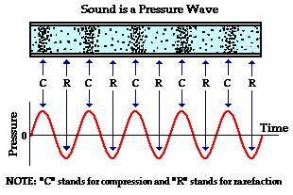
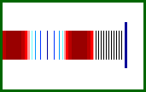
Transverse Representation
For simplicity in representing sound digitally, longitudinal sound waves are encoded transversely as a sinusoidal wave. The amplitude (or height) of the wave represents the sound energy (or pressure) where the peaks are the compressions and the troughs are the rarefactions.
You can think of the sine wave as representing the sound wave on its side
NOTE!: The representation of sound by a sine wave is used to encode the sinusoidal nature of the pressure-time fluctuations. Do not conclude that sound is a transverse wave which has crests and troughs. Sound waves traveling through air are indeed longitudinal waves with compressions and rarefactions. As sound passes through air (or any fluid medium), the particles of air do not vibrate in a transverse manner – they bump against each other transferring energy of the source vibration.
Notes:
Even air molecules obey Newton’s third law of physics: every action has an equal an opposite reaction. Note that the vertical animation is a good example of an ear-drum or a microphone – in reverse this would be a speaker!

Slide 9
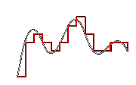
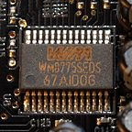
Quantization
In order to create a digital signal from an analog waveform a process known as quantization is used to approximate the infinite continuous range of values by using a discrete set of integer values – this is the same process used for any digital signal processing.
Typically this process is handled by an analog-to-digital converter (abbreviated ADC, A/D or A to D). This device is an electronic integrated circuit (I/C) that converts continuous signals to discrete digital numbers. The reverse operation is performed by a digital-to-analog converter (DAC).
Notes:
Note that this is quantization as it relates to digital signal processing and not quantum mechanics… OK, even though at some level this thing we are treating as a continuous signal for mathematical simplicity ignores the fact that at a quantum level even this sound energy is quantized – but that’s another discussion.

Slide 10
Sampling Rate
Quantization of the analog waveform, or signal, is a real-time process operating over a continuous time-period which produces a “stream” of digital values
In order for the process to work you must define the rate at which new digital values are measured, or sampled, from the analog signal
The rate at which new values are measured is called the sampling rate (a.k.a., the sampling frequency).
Notes:
Take same waveform drawing and divvy it up into sections describing sampling rate.

Slide 11
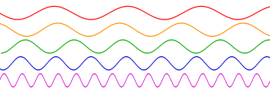
Frequency
Frequency is the measurement of the number of occurrences of a repeated event per unit of time. In the world of sound it is defined as the rate of change of phase in a sinusoidal waveform.
Key definition: Sound energy is created by a vibrating object – the speed of the vibration is the “frequency” of the sound.
Frequency is measured in hertz (Hz) (named after the German physicist Heinrich Hertz). 1 Hz means that an event repeats once per second, 2 Hz is twice per second, and so on. This unit was originally called a cycle per second (cps), which is still sometimes used.
Notes:
Most of you likely know this definition, but before we describe how sound is encoded into a WAV file you need to understand frequency.
Speak to: “amplitude” of a wave being the height (i.e. pressure strength or “volume” of the sounds) and the “frequency” of a wave being occurrences per second by marking up a waveform – you could note that AM radio (amplitude modulation) is a set frequency that modulates the amplitude to create a sound and that FM radio (frequency modulation) is a change in frequency to create sound.

Slide 12
Bits per Sample
Strictly speaking, this describes this describes the total number of bits used to encode the amplitude of a sampled signal:
  8 bit range (1 Byte) : 0 to 255
  16 bit range (2 Bytes) : -32,768 to 32,767
  24 bit range (3 Bytes) : -8,388,608 to 8,388,607
  32 bit range (4 Bytes) : -2,147,483,648 to 2,147,483,647
The net result is that more bits you use, the more resolution you can achieve in amplitude.
Notes:
Same hand drawn waveform can be used to show pixilation of lower number of bits per sample.

Slide 13
Bit Rate
In the digital multimedia world, the bit rate (also spelled bitrate) represents the amount of information, or detail, that is stored per unit of time of a recording. You can think of it in terms of “bits per second”. The bitrate depends on several factors:
    the sampling rate
    number of bits per sample
    data encoding format
Mathematically, bitrate can be defined as follows:
Bitrate = SamplingRate * BitsPerSample
Generally speaking a higher bitrate equates to a higher fidelity digital recording.
Sometimes people refer to a “byterate”, this is simply 1/8 of the bitrate (eight bits in a byte).

Slide 14
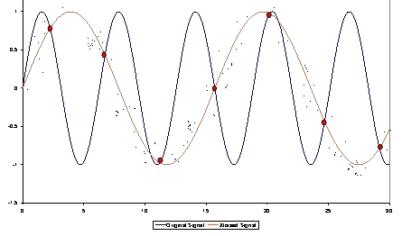
Signal Aliasing
Selecting a good sampling rate is critical in order to properly quantize a waveform. A low sampling rate can cause a phenomenon called aliasing in which the frequency of the converted signal is lower than that of the original signal.
Notes:
Note that this is the same phenomenon that causes a digital picture to appear “pixilated” – draw another waveform beside the other and show a very low sample rate to help describe the “aliasing” effect

Slide 15
Nyquist Frequency
To quantize an analog waveform with good quality, or fidelity, audio is sampled in accordance with the Nyquist theorem (named after the Swedish-American engineer Harry Nyquist).
This theorem describes the Nyquist frequency which is half the sampling frequency of a discrete signal processing system. This frequency is sometimes called the critical frequency.
The theorem tells us that the aliasing phenomenon can be avoided if the Nyquist frequency is greater than the maximum frequency of the signal being sampled.
The Nyquist rate is the minimum sampling rate required to avoid aliasing, equal to twice the highest modulation frequency contained within the signal.

Slide 16
Frequency Range
Audio based Compact Discs (or CD’s) use a sampling rate of 44,100 Hz, hence the Nyquist frequency is 22,050 Hz – this is the upper bound on the highest frequency the digital data can clearly represent without aliasing.
As a result the frequency range (also known as the frequency response) for an audio CD is from 20 to 22,050 Hz.
Note that this frequency selection was no accident, the range of hearing for a healthy young person is 20 to 20,000 Hz.
Notes:
Test hearing range of audience from 20Hz to 22,000 Hz. Note that most children less than 20 years old can hear sounds over 17Khz where many adults cannot.

Slide 17
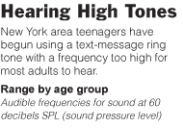
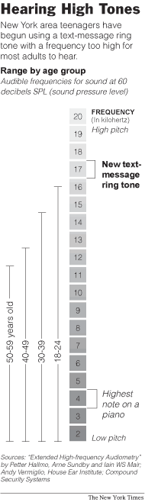

Typical Hearing Range
Species | Approximate Range (Hz)
human | 64-23,000
dog | 67-45,000
cat | 45-64,000
cow | 23-35,000
horse | 55-33,500
rabbit | 360-42,000
rat | 200-76,000
mouse | 1,000-91,000
bat | 2,000-110,000
beluga whale | 1,000-123,000
elephant | 16-12,000
porpoise | 75-150,000
goldfish | 20-3,000
canary | 250-8,000
chicken | 125-2,000
Source: http://www.lsu.edu/deafness/HearingRange.html
Notes:
While most human communication takes place in a frequency range between 200 and 8,000 hertz (a hertz being the scientific unit of frequency equal to one cycle per second), most adults' ability to hear frequencies higher than that begins to deteriorate in early middle age.

Slide 18
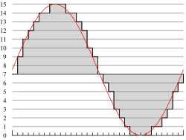
Pulse-Code Modulation
Though a WAV file can hold compressed audio, the most common WAV format contains uncompressed audio in the pulse-code modulation (PCM) format. PCM audio is the standard audio file format for CDs, containing two channels (i.e., stereo) of 44,100 Hz, using 16 bits per sample.
Pulse-code modulation is simply a form of quantization

Slide 19
Waveform Encoding
Microsoft defines 133 different audio waveform encoding formats for WAVE files – PCM is the most common
The PCM encoded WAV file is the intermediate standard for *all* sound data in Windows – it is uncompressed and represents raw sound, quantized according to the defined bit rate (i.e., bits per sample and sample rate)
Although pulse-code modulation can be defined to use any number of bits, the WAV file bits per sample must be a multiple of 8 (typically 8, 16, 24 or 32 bits).

Slide 20
Soundcard Capabilities
Now that these definitions have been defined, you should have a better idea of what some of these typical soundcard hardware specifications actually refer to:
Frequency Response: 20 Hz – 20 kHz
  Range of generated frequency (like you’re gonna hear anything outside that range anyway ☺)
Play/Record Sampling Rate(s): 7 kHz – 48 kHz
  This example says that his hardware can play and record at sample rates up to CD quality sound. Again, Nyquist theorem says you won’t need a higher rate for human ears.
AD/DA Resolution 16 bit
  In real-time this hardware can quantize an analog signal into digital form (and vice versa) with 16-bit precision. This is CD quality, however higher A/D resolution = higher quality.

Slide 21

IFF File Format
IFF stands for Interchange File Format (IFF)
The file format is an open standard for encoding any kind of data
It was developed by a small gaming company called “Electronic Arts” in 1985
An IFF file is built up from chunks. Each chunk begins with what the spec calls a “Type ID”. This is followed by a 32-bit unsigned integer specifying the size of the following data (the chunk content) in bytes
Click for standard

Slide 22
Microsoft’s IFF – the “RIFF”
RIFF is a variant of IFF format devised by Microsoft and IBM; RIFF files differ from IFF files in that they have letters RIFF at the beginning and use little-endian integers.
My original guess was that the “R” stood for “Ripped” IFF; but it actually stands for “Resource” – so the full acronym is:
Resource Interchange File Format
WAV files are encoded using RIFF format, but the data can be of any type. AVI, ANI and RMI (Microsoft variant of a MIDI file) files are examples of others files with RIFF formatting.

Slide 23
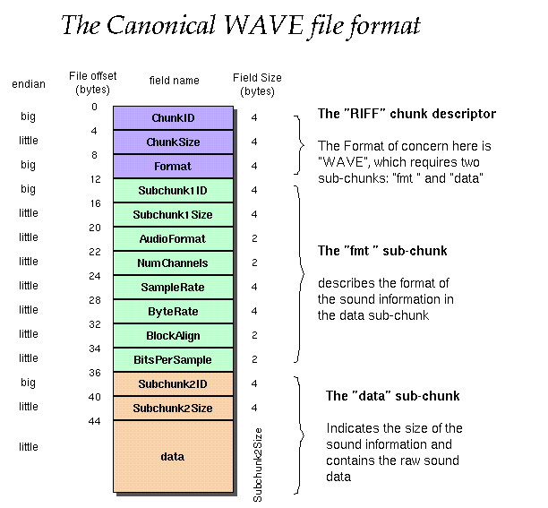
RIFF “Chunk” and “Sub-chunks”

Slide 24
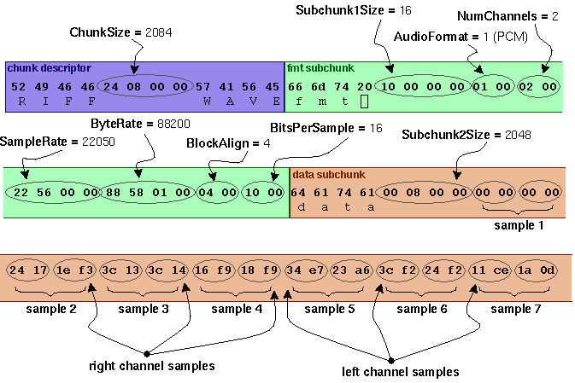
Down to the Bits and Bytes…
Notes:
Note that multiple channels of data like stereo are stored one right after the other… OK, enough of that – now for fun stuff…

